Slide 1

Cloud Security Fundamentals: Protecting Data and Applications
FAYZA KHATOON .A (192521286)
CSA1511 :CLOUD COMPUTING AND BIG DATA ANALYTICS FOR ENGINEERS
Date: 22/07/2026
Technical Presentation

Slide 2
Introduction
Cloud security protects data, applications, and cloud resources.
It ensures Confidentiality, Integrity, and Availability (CIA).
It prevents unauthorized access and cyber threats.
Security follows the Shared Responsibility Model.
Cloud providers secure infrastructure; customers secure data and applications.
Common practices include IAM, encryption, MFA, and monitoring.
What is Cloud Computing?
Provides storage, processing, and computing resources over the internet. Enables scalable and on-demand services.

Slide 3
Types of Cloud Security Threats
Data Breach – Sensitive data is accessed without permission.
Data Loss – Important data is deleted or lost.
Malware – Harmful software that damages systems or steals data.
Phishing – Fake emails or websites that steal passwords.
Weak Passwords – Easy-to-guess passwords that attackers can crack.

Slide 4
Cloud Security Principles
Ensures that only authorized users can access sensitive data.
Ensures that data remains accurate, complete, and is not modified without permission.
Ensures that cloud services and data are available whenever users need them.
Verifies the identity of users before allowing them to access cloud resources.
Grants users access only to the resources and actions they are permitted to use.

Slide 5
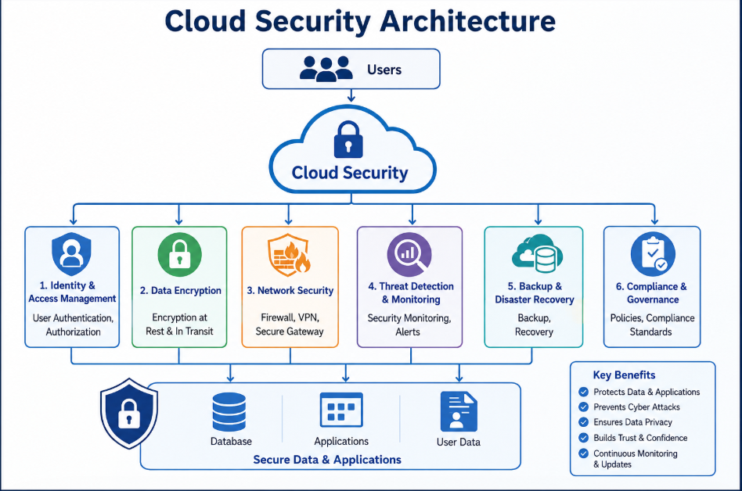
Architecture Diagram

Slide 6
Data Protection in Cloud Computing
Protects sensitive data from unauthorized access and cyber threats.
Encrypts data to keep it secure during storage and transmission.
Creates regular backups to prevent data loss.
Restricts data access to authorized users only.
Monitors data continuously to detect suspicious activities.

Slide 7
Common Cloud Security Challenges
Protecting sensitive data from cyber attacks and unauthorized access.
Managing user access and preventing unauthorized account usage.
Preventing data loss caused by accidental deletion or system failures.
Securing cloud applications from malware and security vulnerabilities.
Ensuring proper cloud configuration to avoid security risks.
Meeting security and compliance requirements to protect user information.

Slide 8
Importance of Cloud Security
Protects sensitive data from unauthorized access and cyber threats.
Ensures the privacy and confidentiality of user information.
Prevents data loss and service disruptions.
Builds trust between organizations and their customers. Helps
organizations comply with security standards and regulations.

Slide 9
Conclusion
Cloud security is essential for protecting data, applications, and cloud services.
Strong security measures help prevent cyber attacks and unauthorized access.
Following security best practices improves data privacy and reliability.
Effective cloud security enables organizations to use cloud technology with confidence.
Continuous monitoring and regular updates help maintain a secure cloud environment.

Slide 10


Thank You ☺

